Slide 1
Water Tanker Management Services Using Django
Presented by:
Chandan V N (1CR21IS038) Manoj Kumar C (1CR22IS408) Umesh T (1CR22IS414)

Slide 2
Problem Overview
Lack of an organized system for managing water tanker services
Challenges in scheduling, tracking, and billing
Inefficiency and resource wastage
Problem Statement: The current management of water tanker services is inefficient due to manual processes and lack of automation. This leads to issues such as scheduling conflicts, delays, difficulty in tracking tanker locations, ineffective communication between customers and service providers, and a lack of centralized billing. These challenges result in resource wastage, decreased customer satisfaction, and financial discrepancies.

Slide 3
Abstract:
The Water Tanker Management Services project aims to transform the traditional management of water delivery through the development of a comprehensive web-based application using Django. This project addresses the inefficiencies and challenges inherent in manual processes such as scheduling conflicts, delays, and difficulty in managing tanker logistics. By leveraging automated scheduling and a centralized billing system, the application will significantly enhance resource management and improve customer satisfaction. The system will facilitate seamless communication between service providers and customers, ensuring transparency and reliability in operations. Through efficient scheduling and dispatch mechanisms, users will be able to plan deliveries effectively, reducing delays and improving overall service efficiency. The project’s ultimate goal is to provide an all-encompassing solution that streamlines operations, reduces resource wastage, and supports scalable growth for water tanker service providers.

Slide 4
INTRODUCTION
Water tanker management services typically involve the efficient scheduling, tracking, and management of water tanker deliveries to various locations such as residential areas, construction sites, or industrial facilities. Using Django, a high-level Python web framework, is a practical choice for developing such a system due to its robustness, scalability, and ease of integration with other technologies. Effective management of water tanker services is crucial for ensuring reliable and efficient delivery of water to households, industries, and communities.

Slide 5
With the increasing demand for water supply, manual management of water tankers can lead to inefficiencies, delays, and wasted resources. To address these challenges, a web-based water tanker management system can be developed using Django, a robust Python framework. This system can streamline operations, enhance customer satisfaction, and reduce costs. By leveraging Django's capabilities, water tanker management services can be optimized, ensuring timely and efficient delivery of this precious resource."

Slide 6
Technologies Used and Their Characteristics
Django (Web Framework)
2. Python (Programming Language)
3. SQLite (Database)
4. HTML, CSS, JavaScript (Frontend Technologies)
5. Bootstrap (CSS Framework)

Slide 7
Plan of Implementation:
Requirement Analysis and Planning
Identify key stakeholders (service providers, customers, administrative staff)
Gather detailed requirements through interviews, surveys, and research
Define project scope, objectives, and deliverables
Develop a detailed project plan and timeline, including milestones and deadlines
System Design
Design the system architecture, including front-end and back-end components
Create database schemas and define data models to manage users, tankers, schedules, and transactions
Design user interfaces and user experience (UI/UX) for intuitive navigation and interaction
We will use:
Dbsqlite3for Database

Slide 8
The system will be built using the Django web framework with SQLite as the database. The architecture will follow the Model-View-Template (MVT) pattern. 1. Model-View-Template (MVT) Architecture
• Model:
o Defines the data structure and relationships using Django’s ORM. o Includes models like Tanker, Customer, and Order.
• View:
o Handles the logic for processing requests and returning responses.
o Includes views for listing tankers, managing orders, and user authentication.
• Template:
o Manages the presentation layer.
o Includes HTML templates for displaying data and forms, styled with CSS and enhanced with JavaScript

Slide 9
2. Database Design
• Database Engine: SQLite (for simplicity and ease of setup)
• Tables:
o Tanker: Stores information about tankers (e.g., name, capacity, availability).
o Customer: Stores customer details (e.g., name, address, contact information).
o Order: Stores order details (e.g., customer, tanker, order date, delivery date, status).
3. User Interface
• Admin Interface: o Django’s built-in admin interface for managing tankers, customers, and orders.
• User Interface:
o Frontend for customers to place orders, view tanker details, and manage their profiles.
o Responsive design using Bootstrap for accessibility on various devices.
4. Technology Stack

Slide 10
• Backend: o Django: Web framework for building the application. o Python: Programming language for application logic. o SQLite: Lightweight database engine for storing data. • Frontend: o HTML/CSS/JavaScript: For structuring and styling web pages. o Bootstrap: CSS framework for responsive design and pre-designed components. • Version Control: o Git: For tracking changes in the source code and collaboration

Slide 11
• Backend: o Django: Web framework for building the application. o Python: Programming language for application logic. o SQLite: Lightweight database engine for storing data. • Frontend: o HTML/CSS/JavaScript: For structuring and styling web pages. o Bootstrap: CSS framework for responsive design and pre-designed components. • Version Control: o Git: For tracking changes in the source code and collaboration
5. Deployment and Maintenance • Deployment: o The application can be deployed on a web server using a WSGI server like Gunicorn and served behind a web server like Nginx. o Optionally, Docker can be used to containerize the application for consistent deployment. • Maintenance: o Regular updates and patches to Django and other dependencies. o Backup and recovery procedures for the SQLite database. o Monitoring and logging for performance and error tracking.

Slide 12
6. Security Considerations
• Authentication and Authorization: o Secure user authentication using Django’s built-in authentication system. o Implement role-based access control for different types of users.
• Data Protection:
o Use HTTPS to encrypt data transmitted between the server and clients.
o Regularly update and patch the application to address security vulnerabilities.
• Input Validation:
o Validate and sanitize user inputs to prevent injection attacks and data corruption

Slide 13
7. Development Workflow
Planning: Define requirements, features, and system architecture.
2. Design: Create wireframes, database schema, and system design.
3. Implementation: Develop models, views, templates, and forms.
4. Testing: Perform unit testing, integration testing, and user acceptance testing.
5. Deployment: Deploy the application to a production environment.
6. Maintenance: Monitor, update, and enhance the application as needed

Slide 14
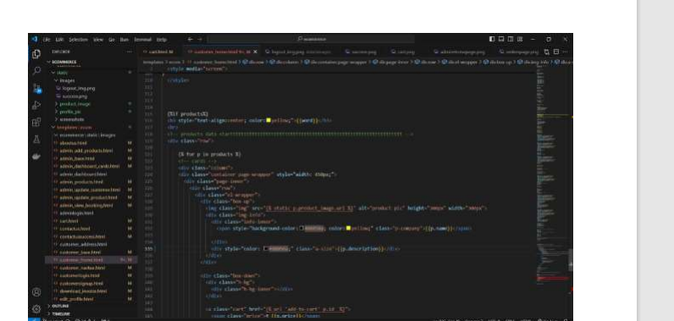
Related Work

Slide 15
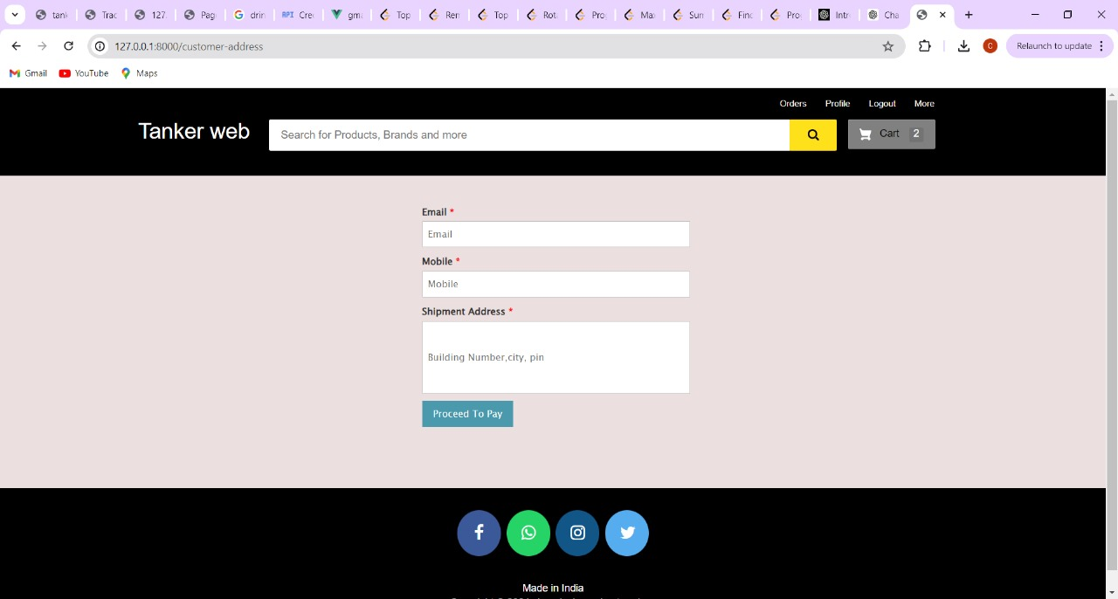

Slide 16
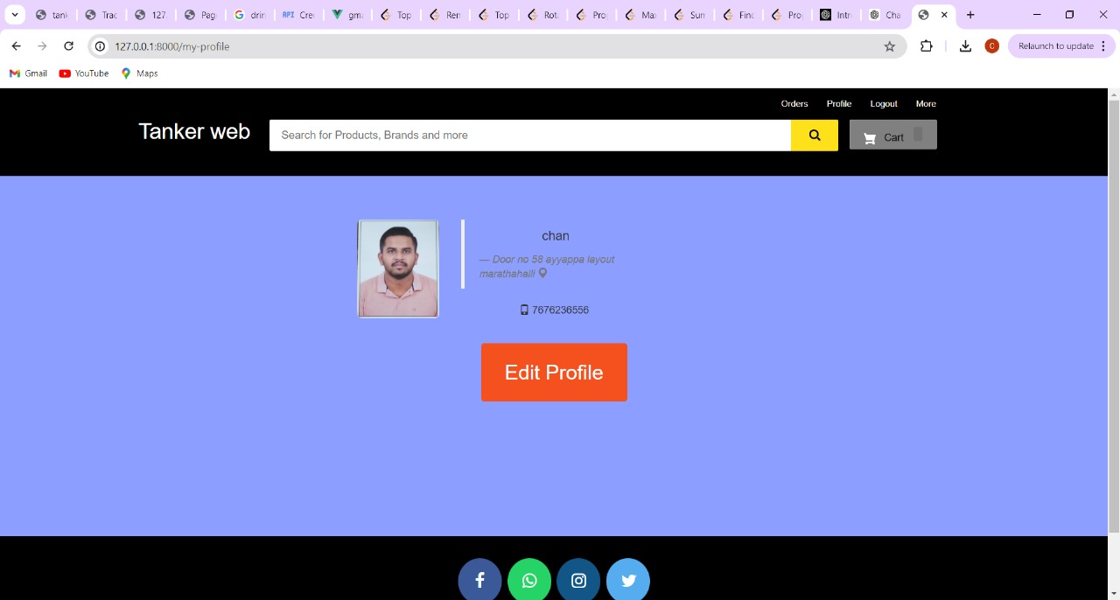

Slide 17
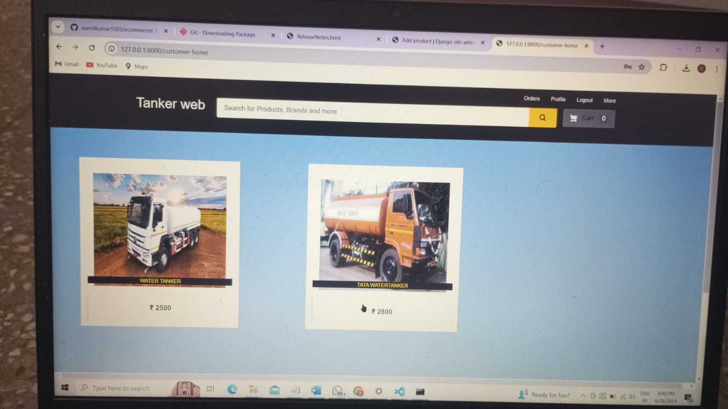

Slide 18
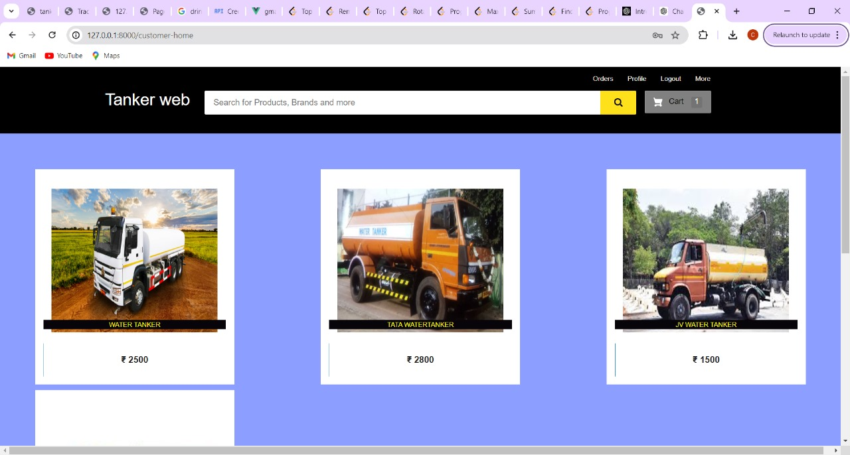

Slide 19
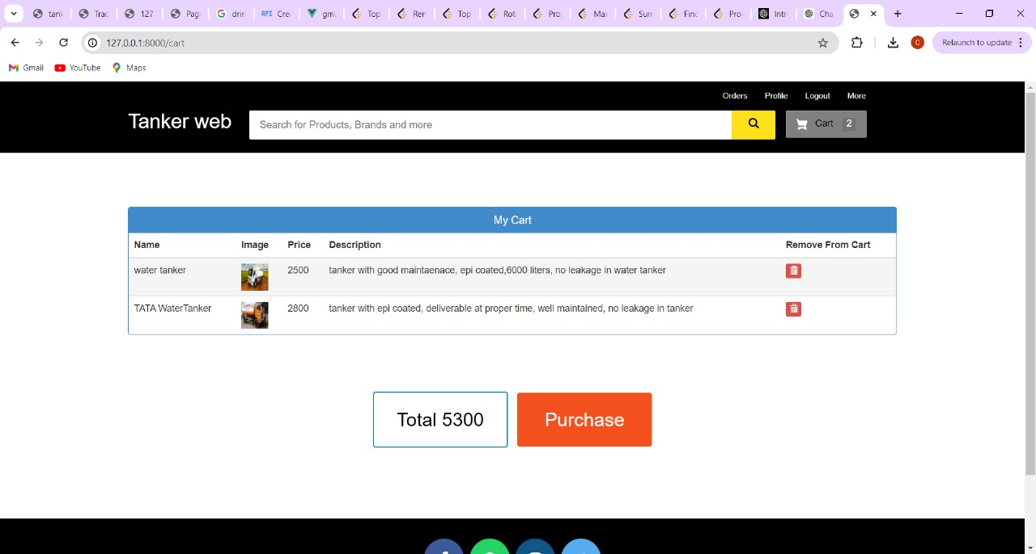

Slide 20
